Slide 1
Virtualization - Containerization

Slide 2
Reading list
Reading list

Slide 3
Virtualisation
Virtualization
Generally
A machine that’s implemented in software, rather than hardware
A self-contained environment that acts like a computer
An abstract specification for a computing device (instruction set, etc.)
Common distinction:
(language-based) virtual machines
Instruction set usually does not resemble any existing architecture
Java VM, .Net CLR, many others
Virtual Machine Monitors (VMM) or Hypervisor
instruction set fully or partially taken from a real architecture

Slide 4
History
History
First VM architected by IBM in 1972 VM/370 to provide full VM of mainframe machine
- 1997 Virtual PC for Mac by Connectix
- 1999 VMware’s VMware Virtual Platform
- 2003 Open Source hypervisor Xen
- 2005 VMware Player – free VM player
- 2007 VirtualBox

Slide 5
Virtualization terminology
Guest OS runs inside the VM, and host OS runs on the PM
Type 1 hypervisor: runs directly on hardware, no need for host OS
Virtual Machine
Type 1 Hypervisor
Hardware (CPU/RAM)
Type 2 (hosted) hypervisor: runs as an application on top of host OS
Virtual Machine
Type 2 Hypervisor
Host OS
Notes:
Physical Machine (PM) → The real hardware (CPU, RAM, disk, etc.).
Host OS → The operating system installed directly on the physical machine (only in Type 2 virtualization).
Hypervisor → Software that creates and manages virtual machines.
Guest OS → The operating system running inside a virtual machine (VM).

Slide 6
Types of Virtualisation
Types of Virtualization
Type 2 Virtualisation - Hosted
Type 1 Virtualisation – Bared metal
Notes:
In Type 1 virtualization, there is no Host OS—the hypervisor runs directly on the PM. In Type 2 virtualization, the Host OS runs on the PM, and the hypervisor runs as an application within it.

Slide 7
Properties of Virtual Machines
Properties of Virtual Machines
Partitioning
Run multiple operating systems on one physical machine.
Divide system resources between virtual machines.
Isolation
Provide fault and security isolation at the hardware level.
Preserve performance with advanced resource controls.
Encapsulation
Save the entire state of a virtual machine to files.
Move and copy virtual machines as easily as moving and copying files.
Hardware Independence
Provision or migrate any virtual machine to any physical server.
VM gives user an illusion of running on a physical machine

Slide 8
VM Components
VM components
1. Virtualise hardware
CPU
Memory
Network interfaces
Disks
2. VM is stored as a file and so can be saved and migrated along with apps and configuration information
3. The aim is to run Operating Systems unchanged however, there is Parvirtualisation
VM OS knows about virtualization and makes specific calls (approach taken by Xen VM)
Notes:
Paravirtualization is a type of virtualization technique where the guest operating system (OS) is aware that it is running in a virtualized environment and can directly interact with the hypervisor. This interaction allows the guest OS to make direct calls to the hypervisor for various operations, bypassing hardware emulation, which can result in improved performance compared to full virtualization
Key Features of Paravirtualization:
Direct Hypervisor Interaction: The guest OS communicates directly with the hypervisor using "hypercalls," which are software instructions that facilitate this interaction46.
Modified Guest OS: For paravirtualization to work effectively, the guest OS must be modified to be aware of the virtual environment and to use the paravirtualization interface34.
Performance Benefits: Paravirtualization offers better performance by reducing the overhead associated with hardware emulation in full virtualization15.
Resource Management: Resources are dynamically managed and can be resized based on needs, turning VMs into flexible bundles of resources

Slide 9
How it works
How it works
Operating systems normally run in privileged mode
VM OSs run in user mode
Most instructions can execute by hardware without hypervisor intervening
Resource management (memory, peripherals) handled by hypervisor
In VM privileged instructions are “trapped” by the hypervisor and emulated
Intel and AMD have added instructions to make this possible (not used by VMware)

Slide 10
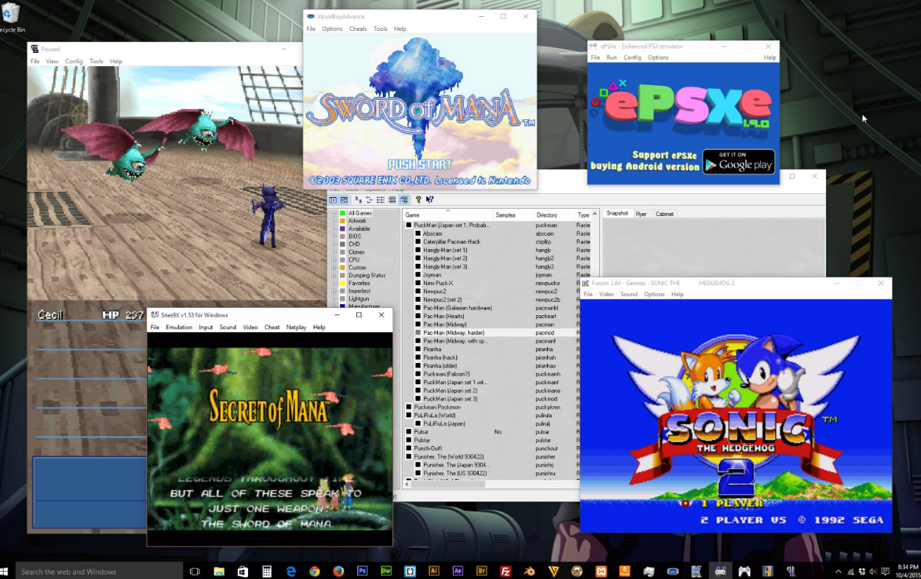
Binary Translation
Binary Translation
• Emulation:
– Guest code is traversed and instruction classes are mapped to routines that emulate them on the target architecture.
• Binary translation:
– The entire program is translated into a binary of another architecture.
– Each binary source instruction is emulated by some binary target instructions.
Notes:
Emulation in the context of virtualization involves mimicking the behavior of hardware or software so that applications or operating systems designed for one environment can run on another. This is typically used when the guest operating system or application is not compatible with the host hardware. Emulation acts as a translator, converting instructions or data from the guest system into a format that the host system can understand and execute.
Binary translation is a technique used in virtualization to translate binary code from one instruction set architecture (ISA) to another. This is crucial when running guest operating systems or applications on host hardware with a different ISA. Binary translation involves dynamically translating the guest code into host-native code, allowing it to execute directly on the host hardware without the need for full emulation.

Slide 11
Dynamic Binary Translation
Dynamic Binary Translation
Guest Code
Translation Cache
vPC
mov ebx, eax
mov ebx, eax
start
cli
mov [CPU_IE], 0
and ebx, ~0xfff
and ebx, ~0xfff
mov ebx, cr3
mov [CO_ARG], ebx
sti
call HANDLE_CR3
ret
mov [CPU_IE], 1
test [CPU_IRQ], 1
jne
call HANDLE_INTS
jmp HANDLE_RET
Courtesy Scott Define VMware Inc

Slide 12
AWS VM
AWS VM
AWS uses different configurations that use Xen
AWS Nitro – a hypervisor based on KVM
AWS also offers actual ”bare metal” machines – with no virtualization
Different VM types are represented by AMIs that are either
PV paravirtual (Linux only)
HVM hardware virtual machine (Linux and Windows)
Notes:
The AWS Nitro System is the underlying platform for our next generation of EC2 instances that enables AWS to innovate faster, further reduce cost for our customers, and deliver added benefits like increased security and new instance types.
AWS has completely re-imagined our virtualization infrastructure. Traditionally, hypervisors protect the physical hardware and bios, virtualize the CPU, storage, networking, and provide a rich set of management capabilities. With the Nitro System, we are able to break apart those functions, offload them to dedicated hardware and software, and reduce costs by delivering all of the resources of a server to your instances.

Slide 13
VMs and Security
VM and Security
Hypervisor security
Hypervisor, applications, drivers and libraries are loaded in randomized memory locations to stop exploites
VMWare uses digital signatures to verify modules drivers and applications – much as iOS and Android do
However – Hypervisor represents an “attack surface” not present in native OSs and so they are subject to vulnerabilities
Virtualized OS
Same vulnerabilities as a non-virtualized OS
VM to VM
Theoretically possible to access memory in one VM from another but very hard to do
AWS itself introduces security vulnerabilities – e.g. access to keys, usernames and passwords

Slide 14
Other types of virtualization
Other Type of Virtualization
Web Server
Virtual hosts using a different hostname, configuration file
Virtual Environments
Java, Python and Ruby amongst others have the ability to configure separate versions of language and libraries
Containers
Like VMs but run in user space and packages binaries and libraries
Docker, Kubernetes, AWS Containers (Docker)
Serverless Environments
Code is executed in response to an event, including HTTP

Slide 15
Other topics in virtualization
Other Topics of Virtualization
VM live migration and related ideas
VMs can moved from one physical machine to another
Why? Maintenance of machines in the cloud, fault tolerance etc.
How are VMs migrated without impacting the application in it?
Use similar techniques for other uses like VM checkpointing
Containers: lightweight virtualization technique
Underlying Linux concepts of namespaces, Cgroups
Container frameworks like LXC, Docker, Kubernetes
Notes:
VM live migration allows a running virtual machine (VM) to be transferred from one physical host to another with minimal downtime. This process is crucial in cloud environments and enterprise data centers.
There are several reasons why VM migration is necessary:
Maintenance in the Cloud:
Physical servers in a cloud data center require maintenance (e.g., hardware upgrades, firmware updates). Live migration allows administrators to move VMs to another machine without shutting them down.
Fault Tolerance & Load Balancing:
If a physical server is under heavy load or experiencing hardware degradation, VMs can be moved to healthier machines.
In the event of an impending hardware failure, migrating VMs can prevent service disruption.
Energy Efficiency:
Some cloud providers consolidate workloads onto fewer machines during off-peak hours, allowing unused servers to be powered down to save energy.
Disaster Recovery & High Availability:
In case of disasters or emergencies, VMs can be relocated to different regions or data centers to ensure business continuity.

Slide 16
Motivation for Containerization
VMs are great, but have high runtime overhead
Can we scale faster and more easily?
What if we could sandbox VMs, but share the OS kernel?
Enables different software architectures and practices
Notes:
Virtual Machines (VMs) provide strong isolation by running a full guest OS on top of a hypervisor. While this is great for security and compatibility, it comes with significant overhead due to:
Resource Duplication
Each VM requires a full OS instance, consuming CPU, memory, and storage.
Redundant system processes (e.g., multiple OS kernels running inside different VMs).
Boot Time & Performance
A VM may take minutes to boot compared to a few seconds for a container.
Hypervisor-based virtualization adds latency due to indirect access to hardware resources.
Inefficient Scaling
Scaling up means provisioning more VMs, which involves OS boot-up and resource allocation delays.
Cloud providers mitigate this with VM snapshots, but it’s still slower than container scaling.
Can We Scale Faster and More Easily?
Yes! Instead of launching full VMs, we can use containers, which:
Share the host OS kernel, eliminating the need for a full OS per instance.
Have faster startup times (milliseconds to seconds).
Use fewer system resources, enabling higher density per machine.
Are more lightweight, making horizontal scaling (spinning up/down instances) quicker and more efficient.
Example:
VM Scaling: Need to spin up a new VM, which involves allocating resources and booting an OS.
Container Scaling: Simply start a new process within an already running OS, reducing startup time.
This is why cloud-native applications and microservices favor containers over VMs for running large-scale distributed systems.

Slide 17
Containers
Containers
Containers are cut down VMs used to execute code in a isolated environment
Docker
Originally based on Linux Containers (LXC) but now on runC
All Docker containers use the same underlying OS but present various parts of the OS as if they were dedicated to the running system
Notes:
Containers provide lightweight virtualization by isolating applications at the process level, rather than emulating an entire machine like a VM. This means:
Isolation: Each container runs as if it has its own OS, but it actually shares the host OS kernel.
Efficiency: Unlike VMs, which require a full OS instance per application, containers only package the application and its dependencies.
Portability: Containers run consistently across different environments (development, testing, production).
It does not run its own kernel—instead, it shares the host OS kernel.

Slide 18
Containers: lightweight virtualization
Containers share base OS, have different set of libraries, utilities, root filesystem, view of process tree, networking, and so on.
VMs have different copies of OS itself
Containers have lesser overhead than VMs, but also lesser isolation
Containers have
separate view of:
Root file system
Libraries and utilities
Process tree
Users
Networking
IPC endpoints
VMs are separate systems with complete copies of OS, user processes.
Guest OS
Base OS / kernel
VMM / host OS

Slide 19
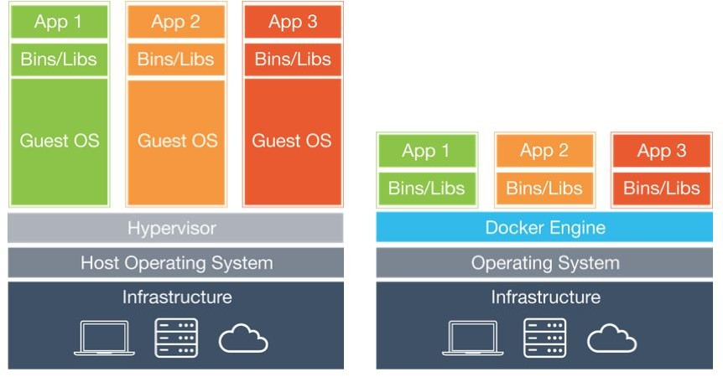
Big Idea: Containers have less OS overhead
Traditional VM-based Infrastructure
Container Infrastructure
https://newsroom.netapp.com/blogs/containers-vs-vms/

Slide 20
Containers
Run Windows Containers on a Linux Host (or Vice Versa)
A Linux container needs a Linux kernel.
A Windows container needs a Windows kernel.
You cannot run a Windows container on a Linux host (or vice versa) natively.
🔹 Solution?
Use Windows Subsystem for Linux (WSL 2) or Hyper-V on Windows to run Linux containers.
Use Windows Server to run native Windows containers.

Slide 21
Namespaces and Cgroups
Two mechanisms in Linux kernel over which containers are built:
Namespaces: a way to provide isolated view of a certain global resource (e.g., root filesystem) to a set of processes. Processes within a namespace see only their slice of the global resource
Cgroups: a way to control resource on a group of processes
Together, namespaces and cgroups allow us to isolate a set of processes into a bubble and set resource limits
Container implementations like LXC, Docker leverage these mechanisms to build the container abstractions
LXC is general container while Docker optimized for single application
Frameworks like Docker Swarm or Kubernetes help manage multiple containers across hosts, along with autoscaling, lifecycle management, and so
Notes:
Container Frameworks: LXC, Docker, Kubernetes
LXC (Linux Containers):
Early container technology that provides OS-level virtualization.
More like lightweight VMs with a full Linux distribution inside.
Docker:
Standardized containerization tool that simplifies application packaging, deployment, and scaling.
Uses a layered filesystem (UnionFS) and image-based workflows.
Kubernetes (K8s):
Orchestrates containerized applications across multiple nodes.
Handles scalability, load balancing, service discovery, self-healing, and rolling updates.
Widely used in cloud-native architectures.

Slide 22
Namespaces
Namespaces
Group of processes that have an isolated/sliced view of a global resource
Default namespace for all processes in Linux, system calls to create new namespaces and place processes in them
Which resources can be sliced?
Mount namespace: isolates the filesystem mount points seen by a group of processes. The mount() and umount() system calls only affect the processes in that namespace.
PID namespace: isolates the PID numberspace seen by processes. E.g., first process in a new PID namespace gets a PID of 1.
Network namespace: isolates network resources like IP addresses, routing tables, port numbers and so on. E.g., processes in different network namespaces can reuse the same port numbers.
UTS namespace: isolates the hostname seen by processes.
User namespace: isolates the UID/GID numberspace. E.g., a process can get UID=0 (i.e., act as root) in one namespace, while being unprivileged in another namespace. Mappings to be specified between UIDs in parent namespace and UIDs in new namespace.
IPC namespace: isolates IPC endpoints like POSIX message queues.
More powerful than chroot() which only isolates root filesystem

Slide 23
Namespaces API
Namespaces API
Three system calls related to namespaces:
clone() is used to create a new process and place it into a new namespace. More
general version of fork().
Flags specify what should be shared with parent, and what should be created new for child (including virtual memory, file descriptors, namespaces etc.)
setns() lets a process join an existing namespace. Arguments specify which
namespace, and which type.
unshare() creates a new namespace and places calling process into it. Flags indicate which namespace to create. Forking a process and calling unshare() is equivalent to clone().
Once a process is in a namespace, it can open a shell and do other useful things in that namespace
Forked children of a process belong to parent namespace by default

Slide 24
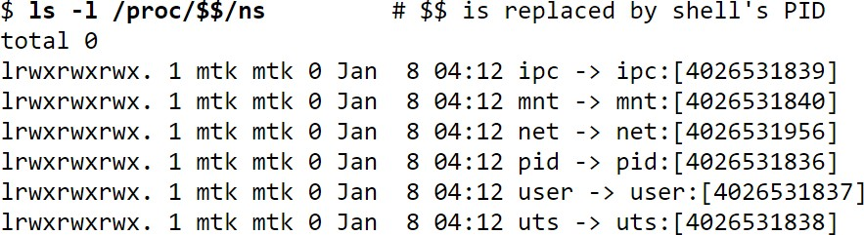
Namespace handles: how to refer to a namespace
Namespace handles: how to refer to a namespace
/proc/PID/ns of a process has information on which namespace a process belongs to. Symbolic links pointing to the inode of that namespace (“handle”)
Namespace handle can be used in system calls (e.g., argument to setns)
Processes in same namespace will have same handle, new handle created when
new namespace created
Namespaces in operation (lwn.net) https://lwn.net/Articles/531114/

Slide 25
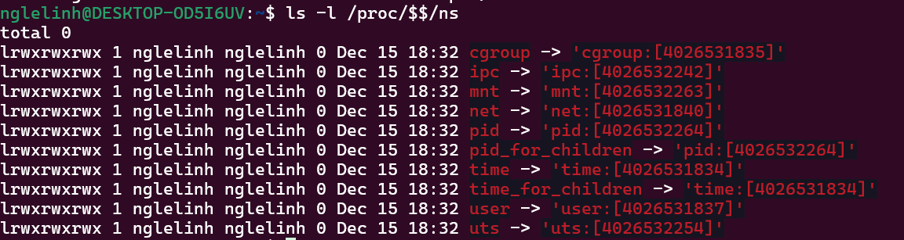
For your current shell:
ls -l /proc/$$/ns
Meaning of the ID (e.g., [4026531835])
This ID uniquely identifies a namespace in the system.
If multiple processes share the same namespace ID, they will share the corresponding resource space.

Slide 26
PID namespaces (1)
PID namespaces (1)
The first process to be created in a new PID namespace will have PID=1 and will act as init process in that namespace
Will reap orphans in this namespace
Processes in PID namespace get separate PID numberspace (child of init gets PID 2 onwards)
A process can see all other processes in its own or nested namespaces, but not in its parent namespace
P2, P3 not aware of P1 (parent PID of P2 = 0)
P1 can see P2 and P3 in its namespace (with different PIDs)
P2=P2’ (just different PIDs in different namespaces)
P1
PID=X1
P2’ P2
PID=X2
PID=1
P3’
P3
PID=X3
PID=2

Slide 27
PID namespaces (2)
PID namespaces (2)
First process in a namespace acts as init and has special privileges
Other processes in namespace cannot kill it
If init dies, namespace terminated
However, parent process can kill it in parent namespace
Who reaps whom?
Init process reaped by parent in parent namespace
Other child processes reaped by parent in same namespace
Any orphan process in namespace reaped by init of that namespace
Q1
P1
Q2
(init)
P2
Q3
P3
Reaped by P2 (init) if orphaned

Slide 28
PID namespaces (3)
PID namespaces (3)
Namespace related system calls have slightly different behavior with PID namespace alone
clone() creates a new namespace for child as expected
However, setns() and unshare() do not change PID namespace of calling process. Instead, the child processes will begin in a new PID namespace
Why this difference? If namespace changes, PID returned by getpid() will also change. But many programs make assumption that getpid() returns same value throughout life of process.
getpid() returns the PID in the namespace the process resides in

Slide 29
Mount namespaces
Mount namespaces
Root filesystem seen by a process is constructed from a set of mount points (mount() and umount() syscalls)
New mount namespace can have new set of mount points
New view of root filesystem
Mount point can be shared or private
Shared mount points propagated to all namespaces, private is not
If parent makes all its mount points private and clones child in new mount namespace, child starts with empty root filesystem
Container frameworks use mount namespaces to create a custom root filesystem for each container using a base rootfs image

Slide 30
Mount namespaces and ps
Mount namespaces and ps
/
How does “ps” work?
Linux has a special procfs, in which kernel populates info on processes
Reading /proc/PID/.. does not read file from disk, but fetches info from OS
procfs mounted on root as a special type of filesystem
P1 clones P2 to be in new PID namespace but uses old mount namespace. We open shell in new PID namespace and run ps. We will still see all processes of parent namespace. Why?
ps command is still using procfs of parent’s mount namespace
How to make ps work correctly within a PID namespace?
Place P2 in new mount namespace, mount a new procfs at root
New procfs at new mount point is different from parent’s procfs
ps will not show only processes in this PID+mount namespace
proc bin

Slide 31
Network namespaces (1)
Network namespaces (1)
Network namespace can be created by cloning a process into a new namespace, or simply via commandline
List of network namespaces can be viewed at /var/run/netns, can use setns() to join existing namespace
Command “ip netns exec” can be used to execute commands within network namespace, for example, to view all IP links:
Namespaces in operation, part 7: Network namespaces https://lwn.net/Articles/580893/

Slide 32
Network namespaces (2)
Network namespaces (2)
Any new network namespace only has loopback interface. How to communicate with rest of network?
Create a virtual Ethernet link (veth pair) to connect parent namespace to new child namespace
Assign endpoints to two different namespaces
Assign IP addresses to both endpoints
Can communicate over this link to parent namespace
Can configure bridging/NAT to connect to wider internet
lo
veth0
veth1
lo
eth0
Namespaces in operation, part 7: Network namespaces https://lwn.net/Articles/580893/

Slide 33
The next building block: Cgroups
The next building block: Cgroups
Namespaces let us isolate processes into a slice with respect to many resources: mount points, PID/UID numberspace, network endpoints, etc.
The next topic Cgroups will let us assign resource limits on a set of processes
Divide processes into groups and subgroups hierarchically
Assign resource limits for processes in each group/subgroup
Which resources can be limited? CPU, memory, I/O, CPU sets (which process can execute on which CPU core), and so on
Specify what fraction of resource can be used by each group of processes

Slide 34

Cgroups hierarchies
Cgroups hierarchies
Can create separate hierarchies for each resource, or a combined hierarchy for multiple resources together
All CPU
All NW
CPU-Faculty
CPU-Students
NW-Web
NW-Non-Web
CPU-NW
40%
60%
50%
50%
Browser process created by faculty
Fac
Web
Fac
Non-Web
Student
Web
Student
Non-Web

Slide 35
Creating cgroups
Creating cgroups
No new system calls, managed via the filesystem
A special cgroup filesystem mounted at /sys/fs/cgroup
Create directories and sub-directories for different resources and different user classes
Write “founding father” task PID to tasks file
All children of this task will be in same cgroup too
Tasks can be assigned to leaf nodes in hierarchy
Tasks will belong to default cgroup of parent if not explicitly placed into any hierarchy
Documentation/cgroups/cgroups.txt https://lwn.net/Articles/524935/

Slide 36
How to create a container?
How to create a container?
Suppose you wish to run an application/shell in a container. How?
Create separate namespaces for isolation
Create and configure cgroups for resource limits
Create root filesystem that is compatible with CPU’s ISA and OS binary
All utilities, binaries, configuration files needed to run the application
A process enters the namespaces, mounts rootfs, registers in cgroups, execs desired application or shell
Your application or shell is running in a “container”!
Many tutorials online on how to create your own container

Slide 37
Container frameworks
Container frameworks
Existing container frameworks like LXC and Docker do the namespace/cgroup configuration automatically “under the hood”
LXC container is a lightweight VM
Provides standard OS shell interface
Uses namespaces and cgroups under the hood
Docker containers are optimized to run a single application
Docker config file specifies base root filesystem, along with utilities needed to run a specific application
Runs application in a container environment
Easy way to package an application and all its dependencies and run anywhere

Slide 38
Container orchestration frameworks
Container orchestration frameworks
Docker Swarm, Kubernetes – frameworks to manage multiple containers on multiple hosts
Kubernetes – popular container orchestration framework
Runs over multiple physical machines ("nodes") each with multiple "pods“
A pod contains one or more containers within the same network namespace, with the same IP address
Pod is a tier of a multi-tier application (e.g., "frontend", "backend", "database", "webserver")
Kubernetes manages multiple nodes and their pods, e.g., instantiating pods on free nodes, auto-scaling pods when load increases, restarting pods when they crash, etc.

Slide 39
Container orchestration frameworks
What Containers CAN Do
Run Different Linux Distributions on the Same Host
Example: You can run an Ubuntu container on a Red Hat or Alpine Linux host.
Run Applications with Different Dependencies
Each container can have its own set of libraries and binaries.
Example: One container can run Python 3.9, while another runs Python 3.11, even if the host does not have Python installed at all.
Use the Host’s Hardware & System Calls
Containers can access network interfaces, storage, and CPUs as if they were directly running on the host.
Example: A TensorFlow container can access the host’s GPU using NVIDIA drivers.

Slide 40
Summary
Summary
Containers provide lightweight isolation with lower overhead
Containers share same kernel binary, have different root filesystems (utilities, configurations) over the kernel
Implemented using two Linux primitives
Namespaces for isolation
Cgroups for resource limits
Frameworks like Docker, LXC, Kubernetes provide more functionality by building upon these primitives
Namespaces in operation (lwn.net) https://lwn.net/Articles/531114/
Documentation/cgroups/cgroups.txt https://lwn.net/Articles/524935/

Slide 41
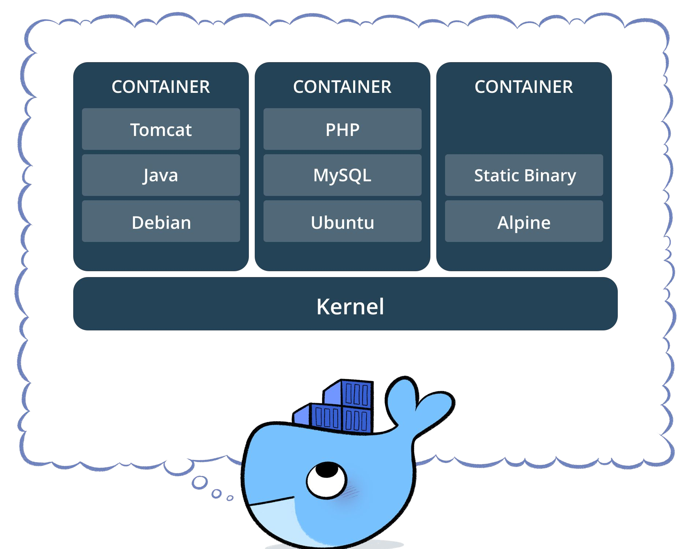

Slide 42
Docker Concepts
Image
Frozen description of an environment
Container
Running instantiation of an image
Volume
Persistent data storage

Slide 43
Docker Concepts
Dockerfile
Describes everything your container needs:
Dependencies
Source Code / Binaries

Slide 44
The Dockerfile
Overview Guide to Running Code in Docker:
Inherit from a parent OS/platform container
Install any packages / libraries you need
Add any source code you need
Attach any volumes you need for data persistence
Set a command to be run at startup

Slide 45
The Dockerfile
Essential Commands:
FROM - Inherit from a parent container
i.e. “FROM ubuntu”
RUN - Runs a command during the build process
i.e. “RUN apt-get install python3”
ADD - Copies files from the build directory into the image
i.e. “ADD hello_world.py /usr”
EXPOSE - Register a port that the image will listen on
i.e. “EXPOSE 80”
CMD - Set the default command to be executed on startup
i.e. “CMD python /usr/hello_world.py”

Slide 46
The Dockerfile
Each command in a Dockerfile creates an intermediate image
Useful for caching!
Structure your Dockerfiles to take advantage of caching
Install packages first, then add source code
Within reason, “Funnel down” from most general to most specific

Slide 47
Where to go from here
Docker Swarm
Pools multiple Docker engines into a combined virtual host
Allows multiple VMs to collaborate to host clustered Docker containers
Docker Compose
Orchestrate multiple-container applications
Declarative format for configuring volumes, container networking, and scaling

Slide 48
Docker Architecture
Docker Architecture
Server (dockerd) long running daemon process
Manages data, network, processes, communication, etc
REST API used to communicate with server
CLI to execute docker containers
Instructions for creating a container is placed in an image
4. Services orchestrate docker containers in swarms
Notes:
Docker Daemon (dockerd): The Core of Docker
The Docker daemon (dockerd) is a long-running background process that manages containers. It handles:
Container Lifecycle – Creating, starting, stopping, and removing containers.
Networking – Setting up container networking (bridge, overlay, host, etc.).
Storage – Managing container file systems and image layers.
Security & Resource Allocation – Using cgroups and namespaces for isolation.
Image Management – Pulling, building, caching, and storing container images.
💡 Example: When you run: docker run -d nginx
The CLI (docker) sends a request to dockerd via the REST API.
The daemon pulls the nginx image (if not already available).
It creates and runs a container using that image.

Slide 49
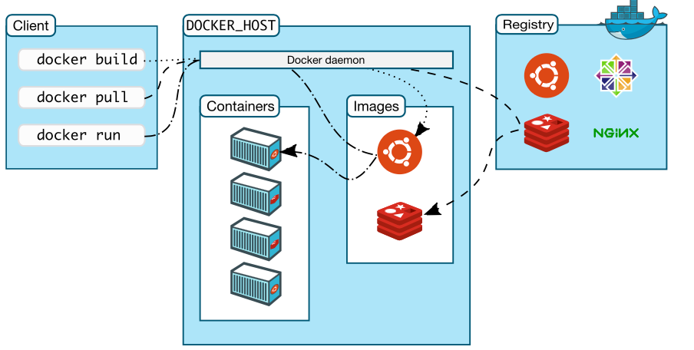
Docker
Docker

Slide 50
Basic Docker commands
Docker CLI commands
docker run – Runs a command in a new container.
docker start – Starts one or more stopped containers
docker stop – Stops one or more running containers
docker build – Builds an image form a Docker file
docker pull – Pulls an image or a repository from a registry
docker push – Pushes an image or a repository to a registry
docker export – Exports a container’s filesystem as a tar archive
docker exec – Runs a command in a run-time container
docker search – Searches the Docker Hub for images
docker attach – Attaches to a running container
docker commit – Creates a new image from a container’s changes

Slide 51
Serverless Computing
Serverless Computing
Fargate is an example of serverless computing
Don’t need to worry about operating systems or maintaining VMs
Other environment for this is Kubernetes
Execution is simply a container or in the case of AWS Lambda just a piece of code
Difference is between how applications get executed and the choice of development environment
Fits in with Micro Service architectures

Slide 52
AWS Lambda
AWS LAmbda
AWS Lambda removes the container details and allows “functions” to be written
Supports different programming environments:
Java, Javscript, Python, C#
Functions can be connected to “events” coming from a number of different environments:
HTTP
IoT
Mobile
Other AWS services like Kinesis

Slide 53
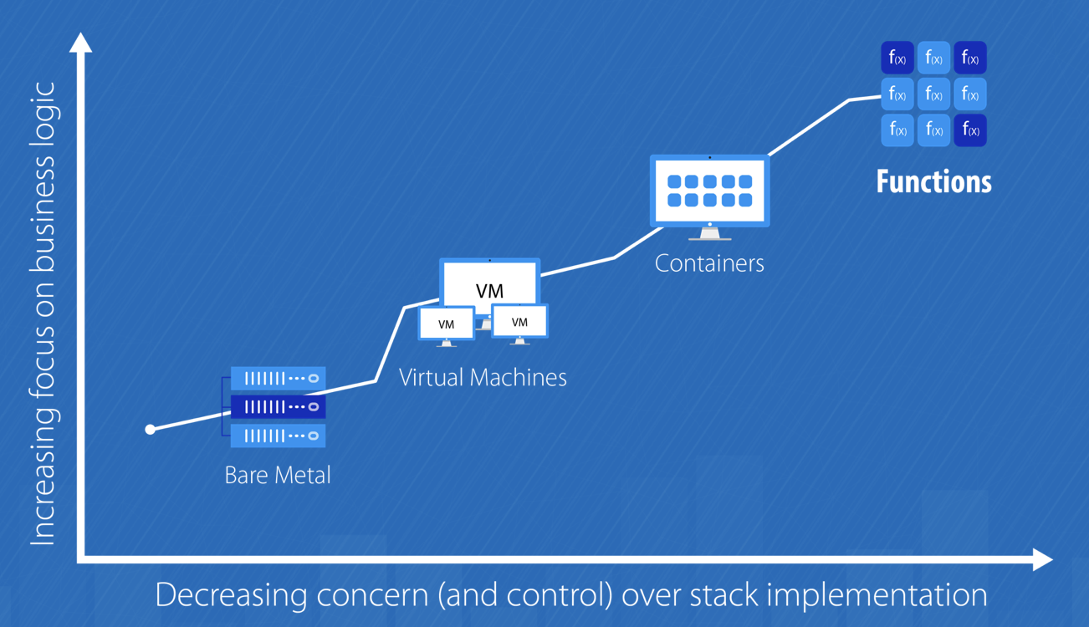
AWS Lambda
Credits: https://medium.com/@amiram_26122/the-hidden-costs-of-serverless-6ced7844780b

Slide 54
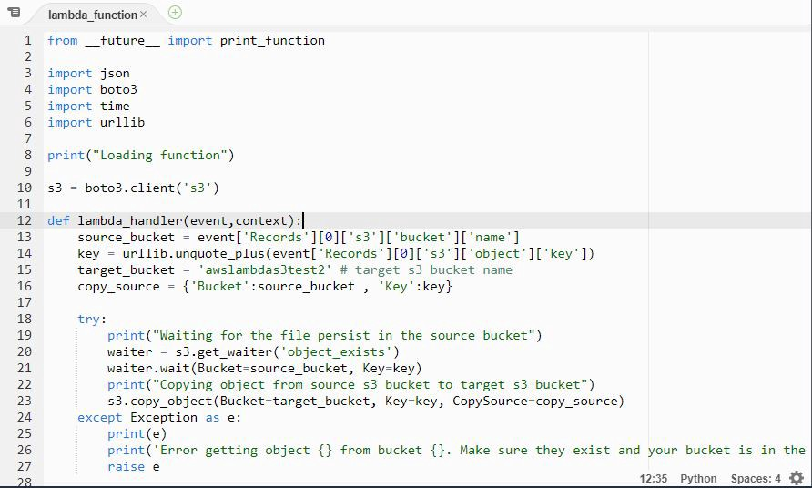
AWS Lambda

Slide 55
Example
Virtualization
Functions need to be packaged and uploaded as zip files
Can be tested locally using SAM CLI – doing much of the same thing as Docker
functions can also be edited using AWS Lambda Console Editor
Create a function
Choose language
Role
Template
Edit code and test

Slide 56
Add an API Gateway
Add an API Gateway
Simple way to associate a URL with a specific function
Allows the specification of functions associated with specific HTTP operations (GET, POST, etc)
Supports CORS Cross Origin Resource Sharing
Makes taking parameters easy

Slide 57
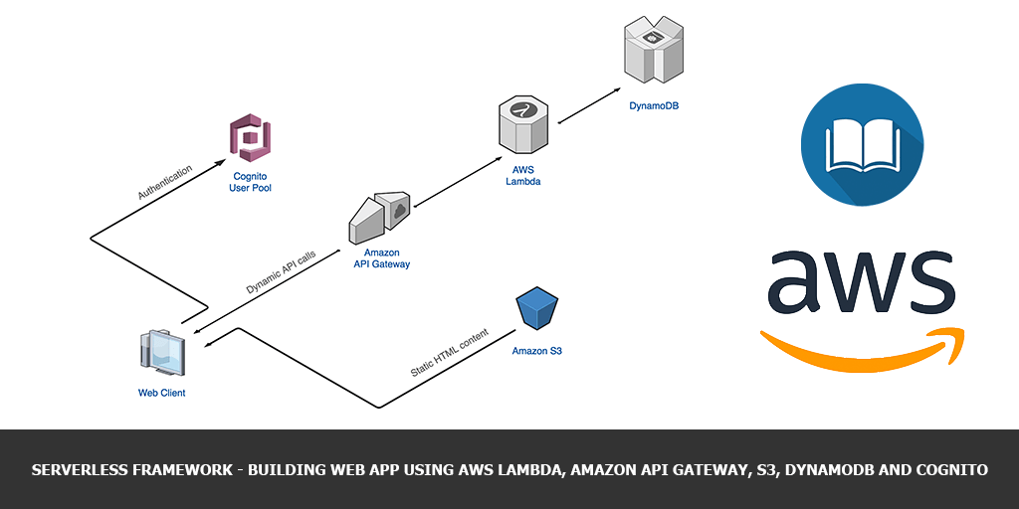
Typical Serverless Architecture in AWS
Typical Serverless Architecture in AWS
Courtesy AWS

